Slide 1

Python Project
Group: Mission to the Moon

Slide 2

Overview
Introduction to Program
Function and code
Import .gz file and generate .json
Read length
Q-Score
Min, max, mean
Visualization to HTML
Demonstration
Help
Analysis
Results

Slide 3
Workflow
Proposal
Input
How many features does your Python program have?
Filtered
Summary text file
Which Python package will you be including and why?
Pandas
NumPy
PyPlot
Ploty
Collections
Biopython
How to communicate with and troubleshoot among team members ?
Once a week – Sat 9.00-10-30am
Each team member's tasks and workload.
Week 1-2 (Kim, Tone) - GitHub setting, convert ASCII → Qscore (dict, etc.) (Nov28, 2022) and Qscore → PHRED score (Dec5, 2022)
Week 1-2 (Champ) – Filter by … length, min-max quality score (Dec12, 2022)
Week 1-2 (Trey) – Visualization – Graph (Dec19, 2022)
Week 3-4 – (All) GitHub upload (Dec26, 2022)
Week 4 – (All) Full test
Week 5 - Presentation
Read Length
convert text → quality
AVG. quality
filter
Report (HTML)
Output File
Notes:
FASTQ file --> วิเคราะห์ข้อมูล
1. บอกความยาวแต่ละ sequence read
2. บอกคุณภาพเฉลี่ยของแต่ละ sequence read --> visualize ข้อมูลทั้งสอง เป็นรูปของกราฟ --> นำ FASTQ file เดิมจากข้อแรกสุด เข้าโปรแกรม filter --> output เป็น FASTQ file ที่ตัด sequence read ที่คะแนนต่ำกว่าต้องการออก
https://github.com/wdecoster/nanofilt
https://biopython.org/docs/1.75/api/Bio.SeqIO.QualityIO.html

Slide 4
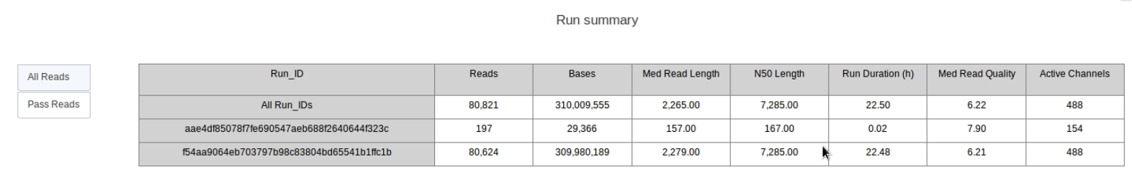
Update 11th Dec 2022
What have we done ?
Github https://github.com/DanudejC/SIRE504_Project
Code from everyone – almost ready
Read .gz
Read length, convert ASCII to Q-score
Filter = min, max, mean
What next ?
เอา code มาต่อกัน
ทำ visual เพื่อดู raw data, length, min, max, mean
Q-score = (input)
Length = (input)
Read no.
Read no.
min
avg
max
min
avg
max
Q-SCore
length

Slide 5
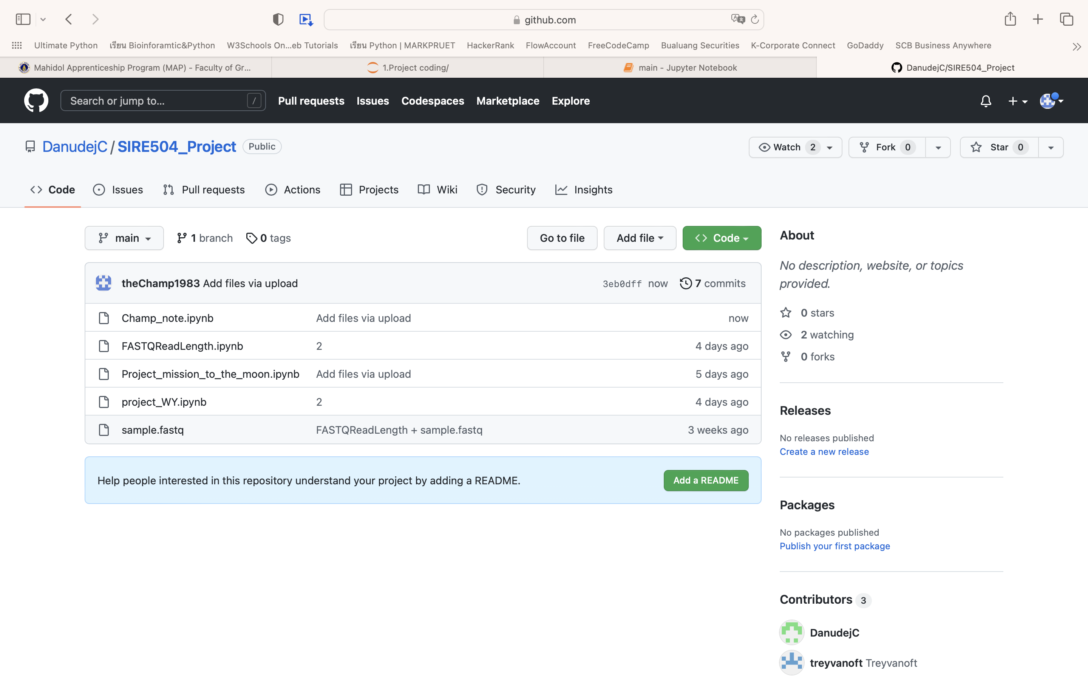
Update 29th Dec 2022

Slide 6
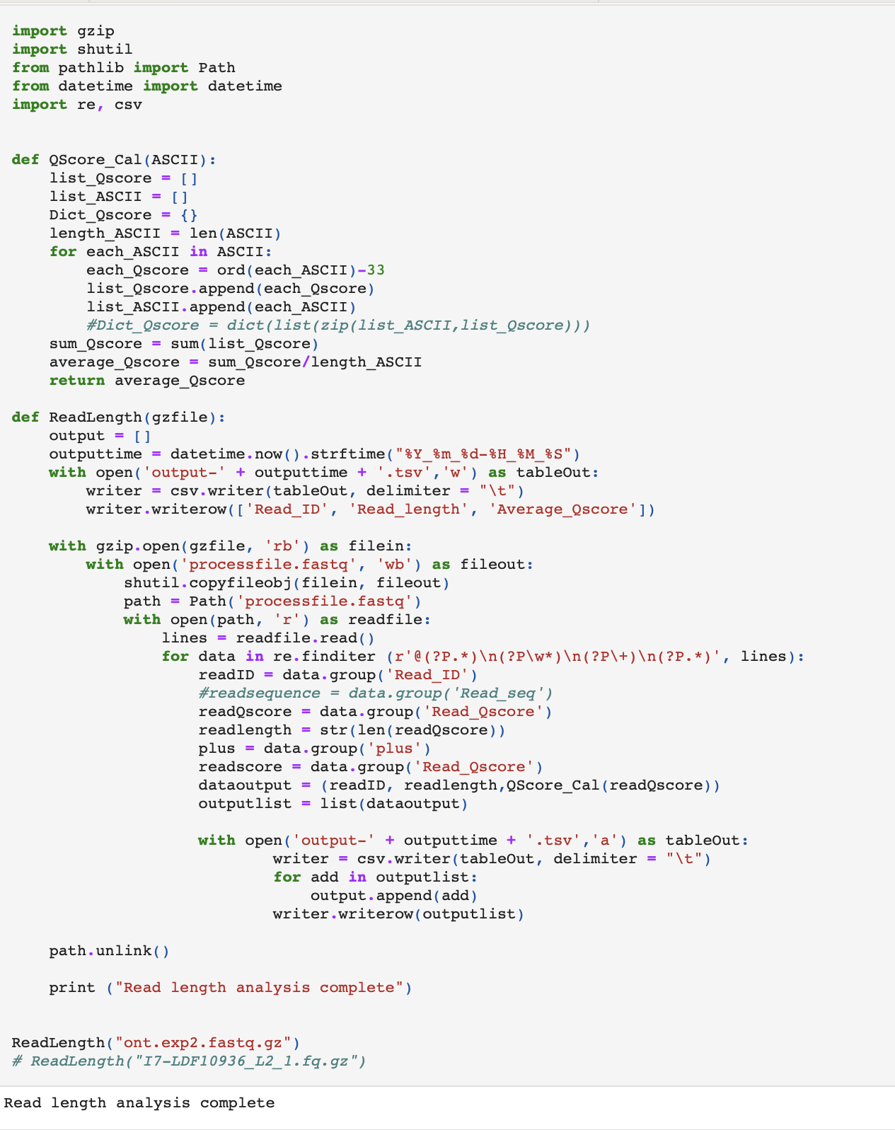
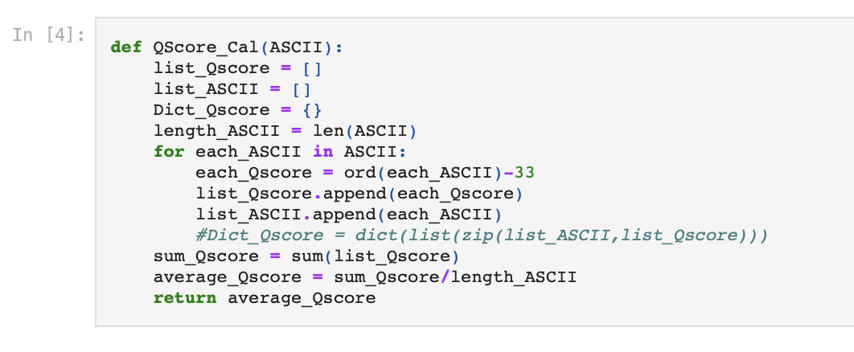
Update 29th Dec 2022

Slide 7
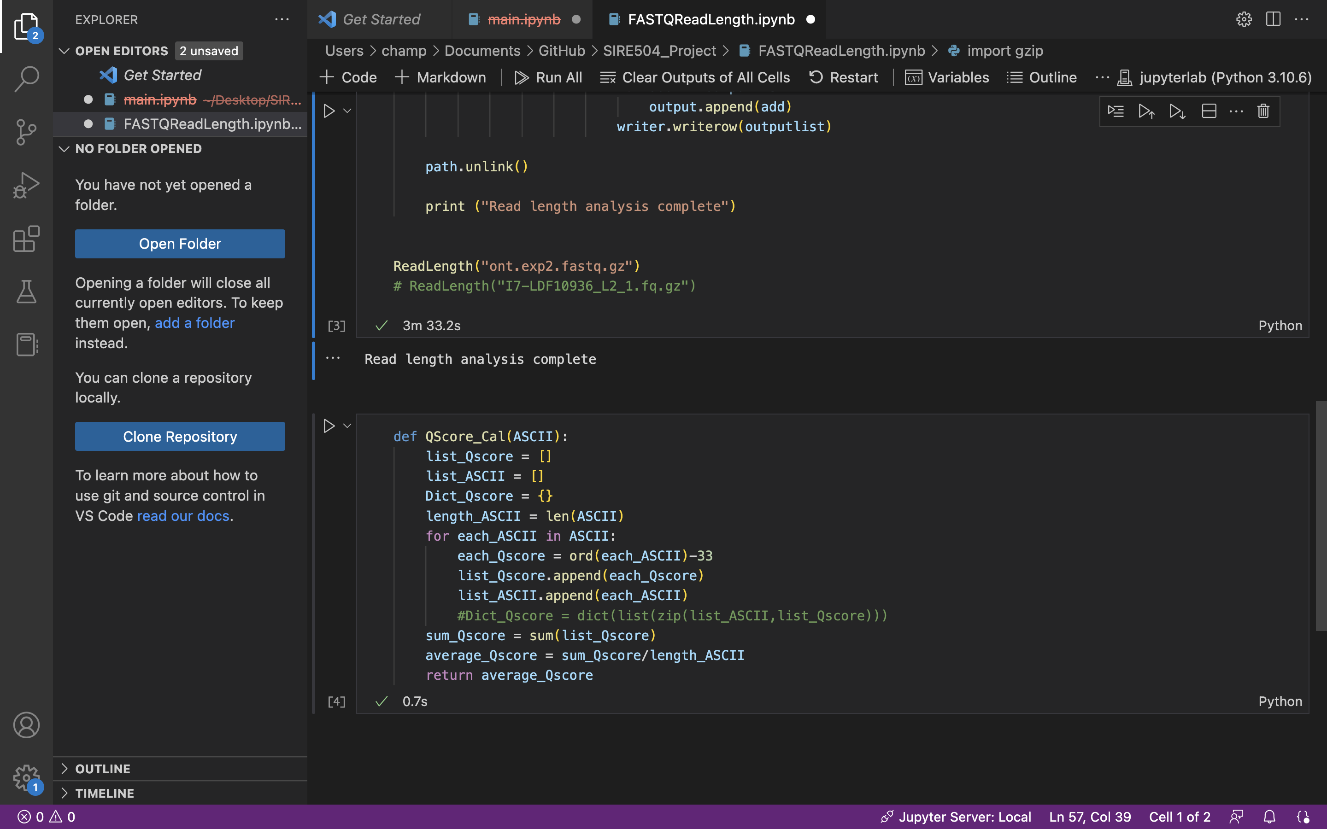
Update 29th Dec 2022

Slide 8
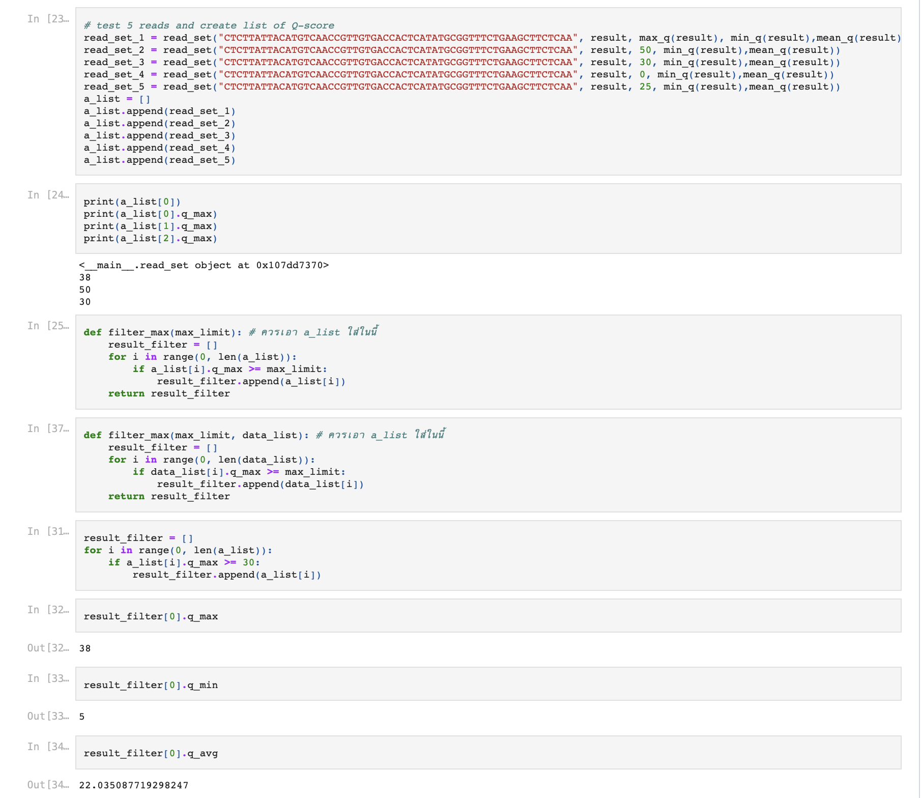
Update 29th Dec 2022

Slide 9


Update 29th Dec 2022
To do next:
Complete code by connect the filter part.
Q-score = (input)
Length = (input)
Read no.
Read no.
min
avg
max
min
avg
max
Q-SCore
length

Slide 10
What our program (myseq) does
Analyze read length and Qscore
Filter reads based on read length and Q-score
Plot graphs among read density, read length and Q-score
Generate summary report in HTML format

Slide 11
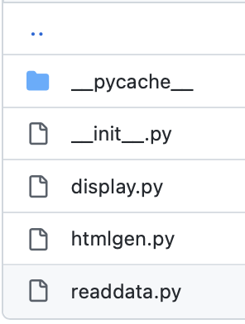
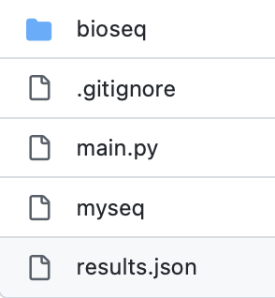
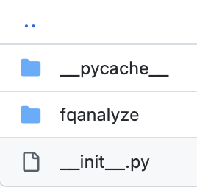
Program package
https://github.com/DanudejC/SIRE504_Project.git

Slide 12
Program Workflow
Run program (myseq)
Calculate read length and Q-score of each read separated by barcode
Input fastq.gz file
Plot graghs among read length, Q-score, and read density
Filter reads based on
desired length and Q-score
Generate summary report in HTML format

Slide 13
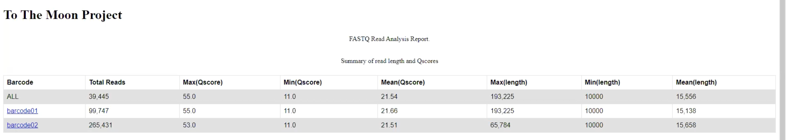
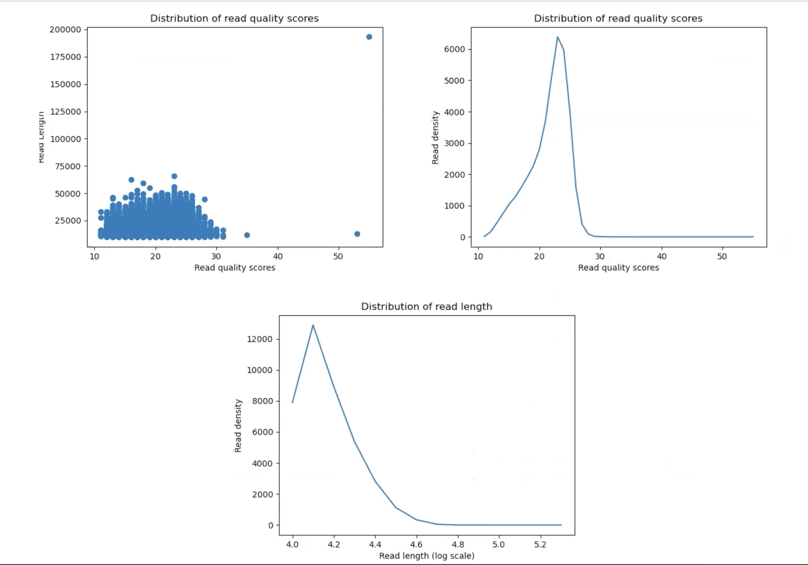
Program Outputs

Slide 14
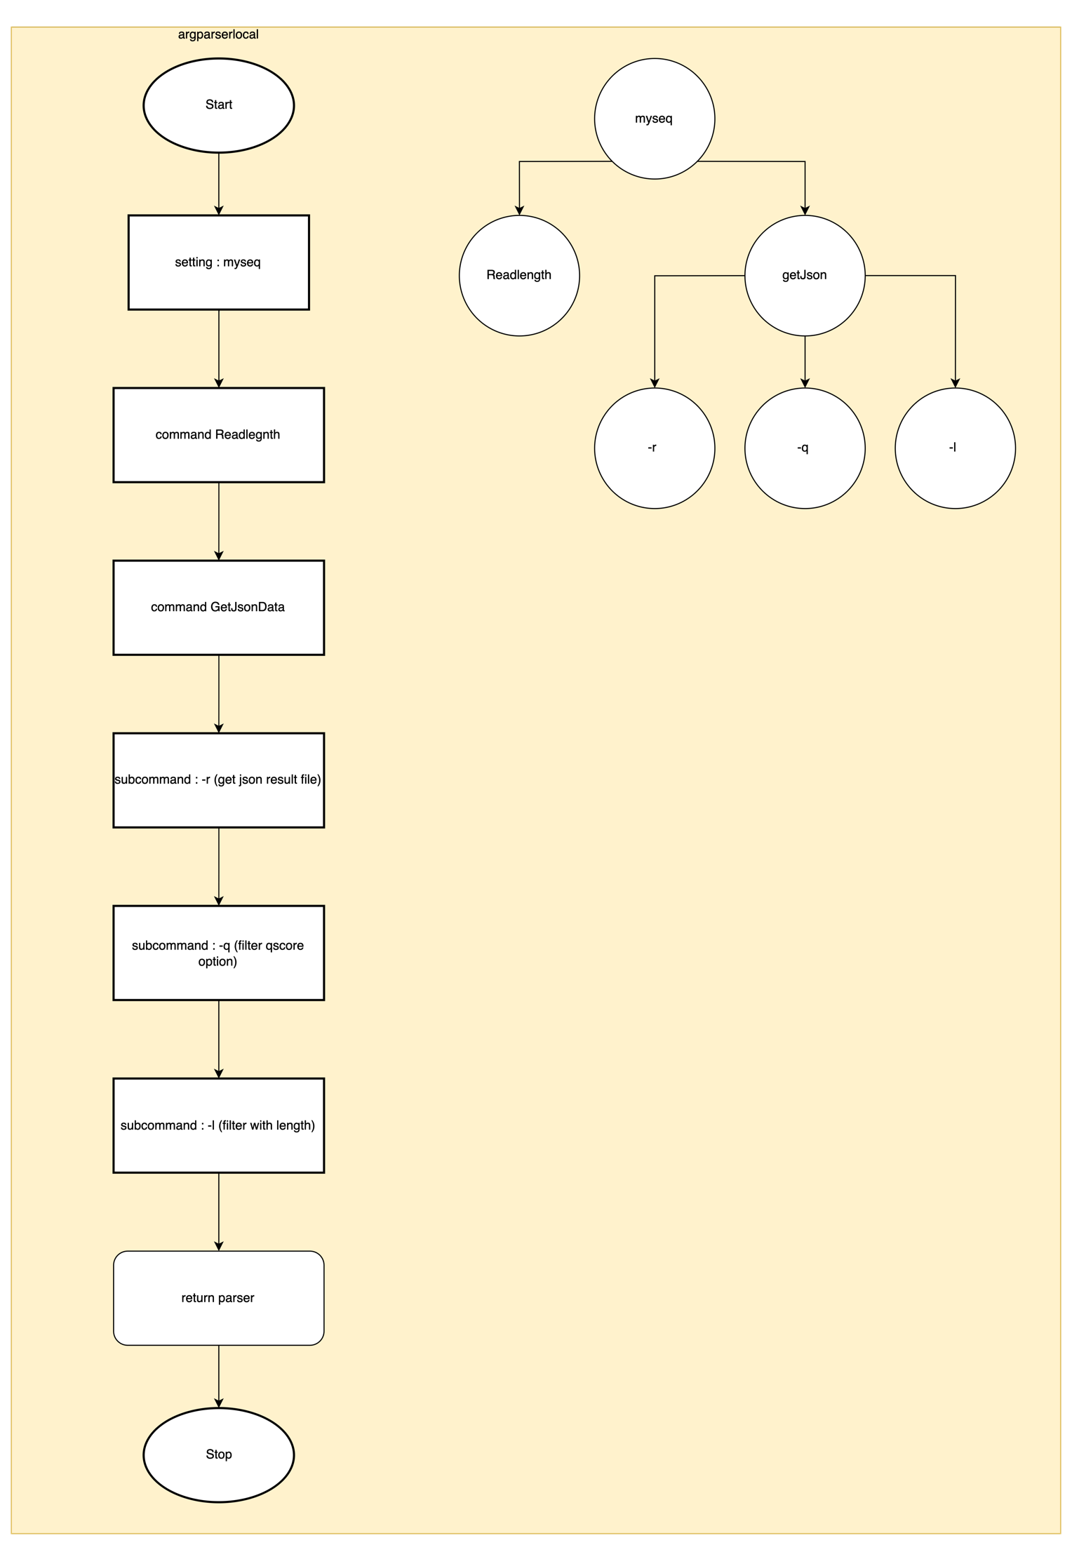
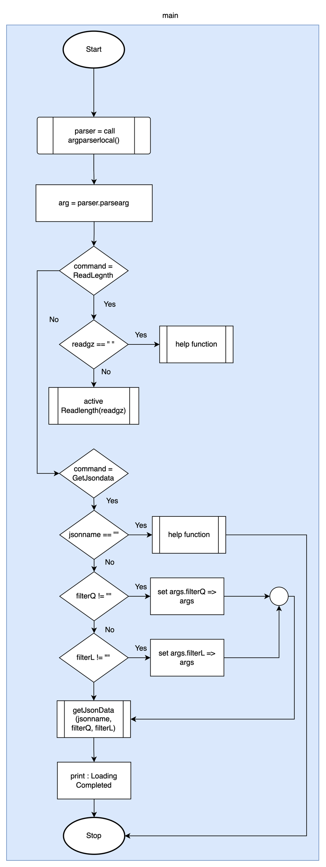
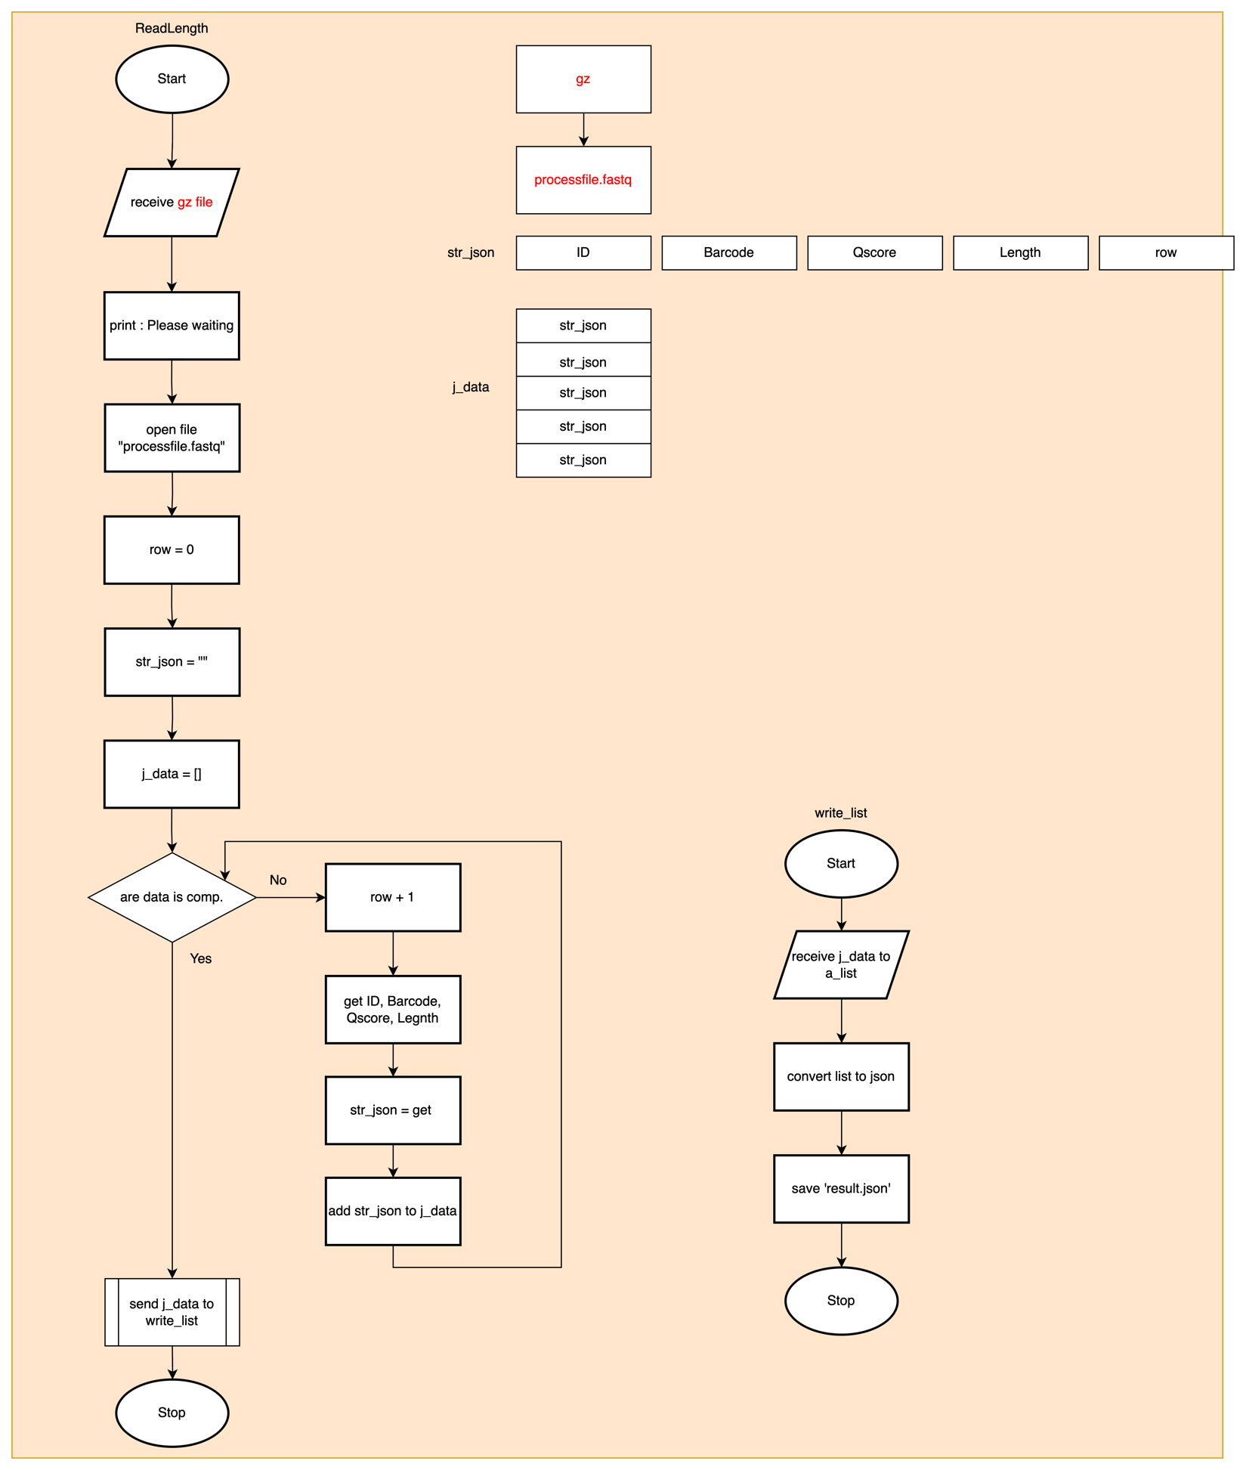
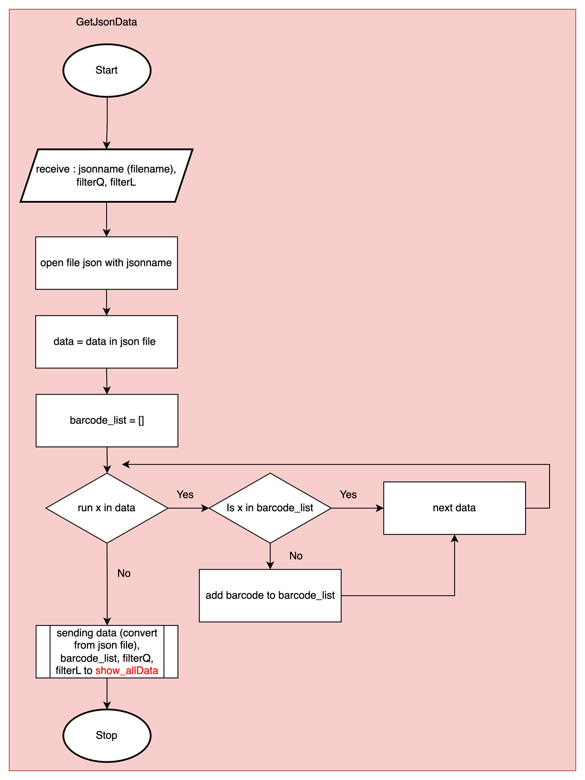
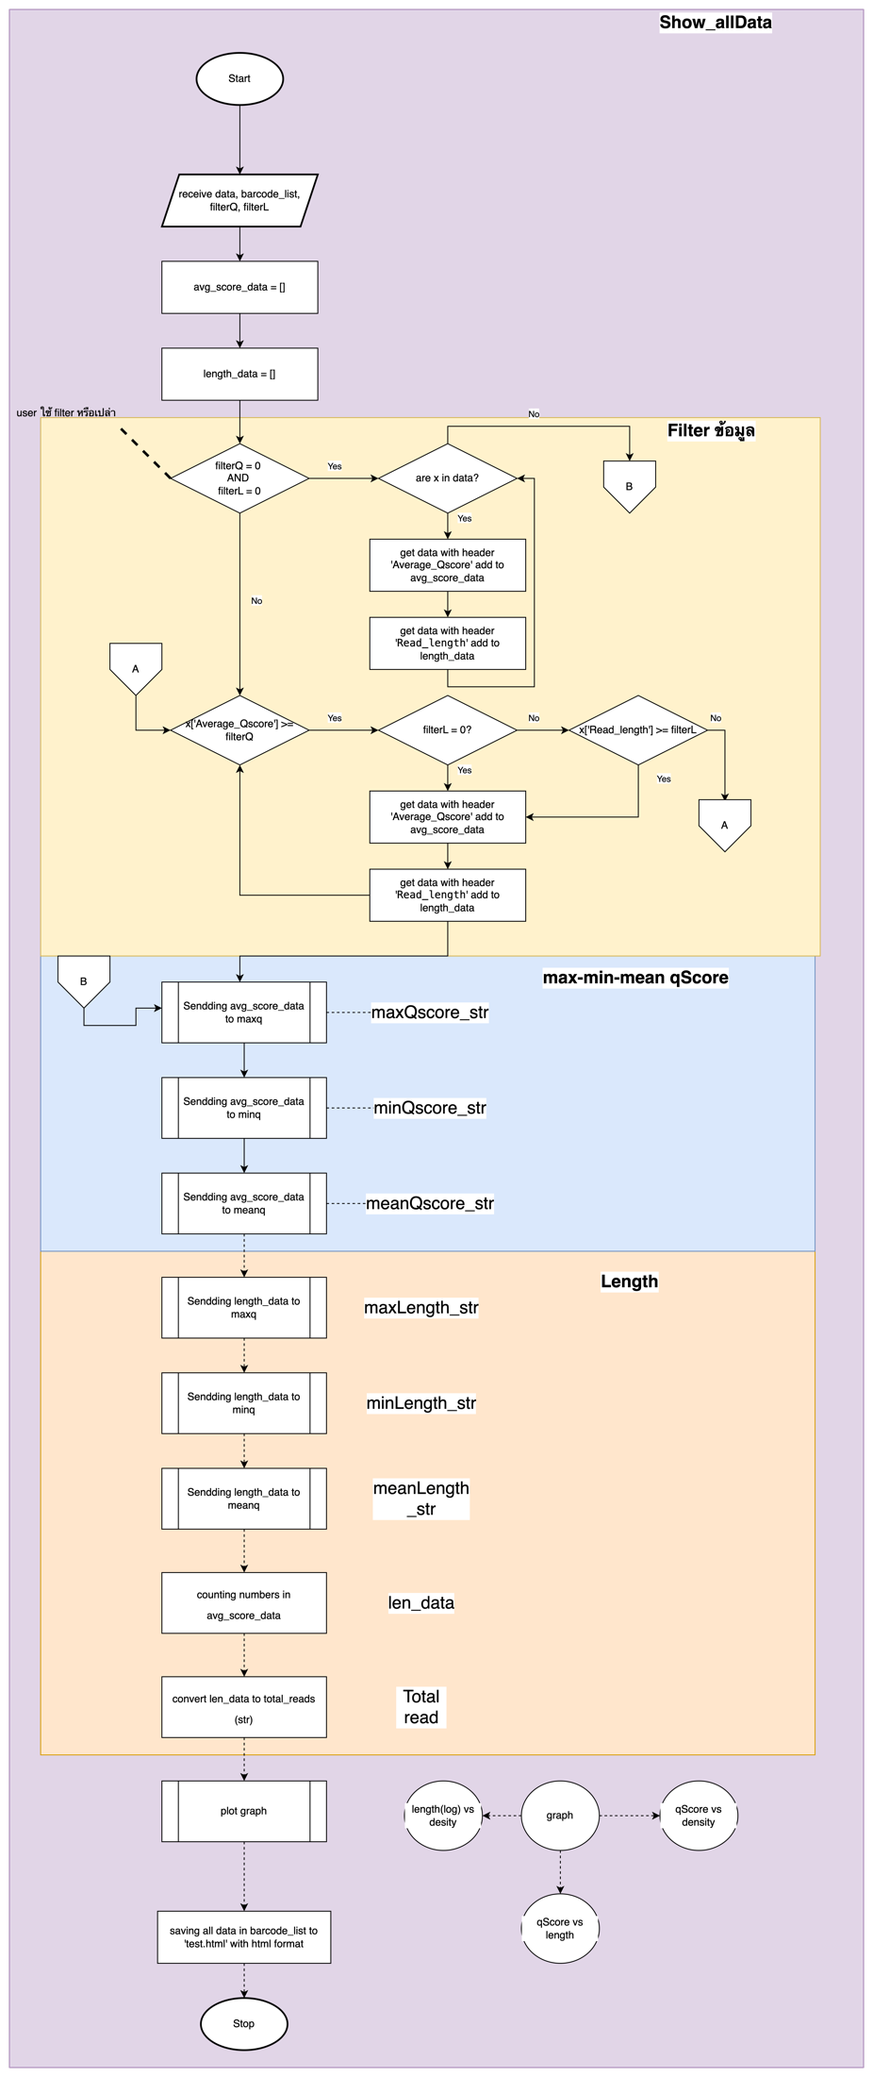
Program Workflow (in details)

Slide 15
Coding
Tone – read file and find Read Length
Kim – Average Q-Score of each read
Champ – Filtering of Q-score and read length
Trey – Visualisation and report

